Slide 1
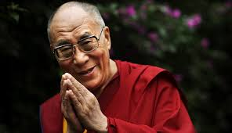
Dalai Lama Nobel Acceptance Speech

Slide 2
Who was Dalai Lama?
14th Dalai Lama- Tenzin Gyatso : Monk of the Gelug School
Conflicts with the People’s Republic of China.
Exile To India
Public Figure

Slide 3
Tibet – China Conflict
Rule of China over Tibet – “CULTURAL GENOCIDE”
Beginning of Corruption in 1933 by RETING.
Exile of Dalai Lama – 1959.
Violence in Tibet started in 1989.

Slide 4
Nobel Peace Prize
Awaded to those who have “done the most or the best work for fraternity between nations, for the abolition or reduction of standing armies and for the holding and promotion of peace congresses”.
Received by Dalai Lama in 1989 after the Tiananmen Square protests.

Slide 5
Key points in the speech
True values of altruism, love, compassion and non-violence.
Representation of everyone who is oppressed and is struggling.
Tribute to Mahatma Gandhi.
Destruction of national and cultural identities of Tibetans.

Slide 6
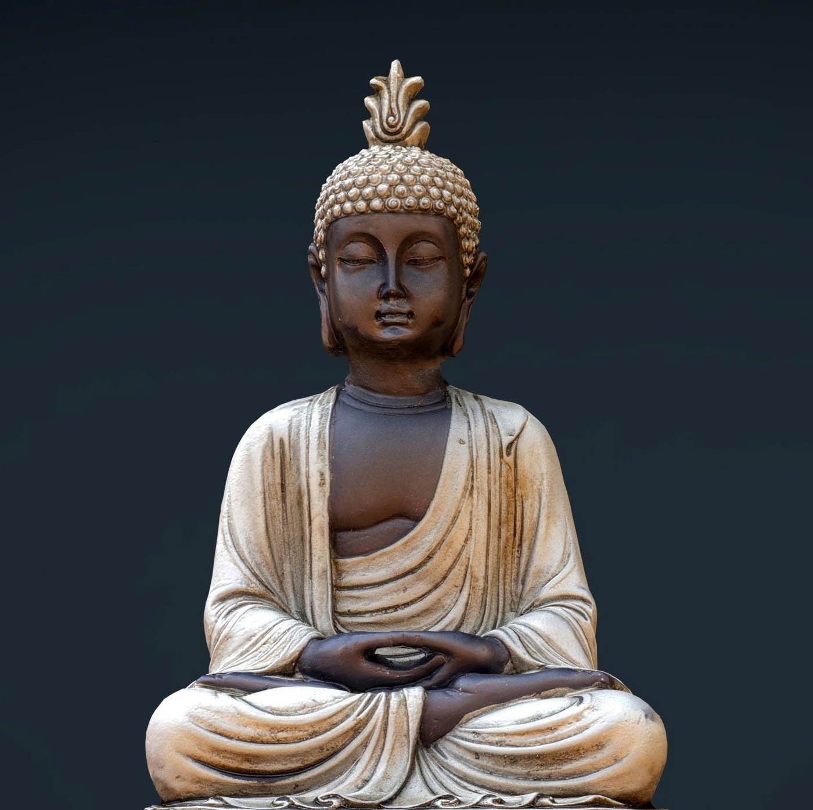
Key Points continued
Wishes for Liberation of Tibet.
“Crime”: To wish for an independent country
Teachings of Buddha
Non-violence:
“We are trying to end suffering, not to inflict our suffering on others.”

Slide 7
FIVE POINT PLAN
This peace plan contains five basic components:
1. Transformation of the whole of Tibet into a zone of peace; 2. Abandonment of China's population transfer policy which threatens the very existence of the Tibetans as a people; 3. Respect for the Tibetan people's fundamental human rights and democratic freedoms; 4. Restoration and protection of Tibet's natural environment and the abandonment of China's use of Tibet for the production of nuclear weapons and dumping of nuclear waste; 5. Commencement of earnest negotiations on the future status of Tibet and of relations between the Tibetan and Chinese peoples.

Slide 8
“Suffering is caused by ignorance”
“True happiness comes from a sense of inner peace and contentment”
Fundamental unity: science and religion
Build a better world with understanding and love

Slide 9
Conclusion
AIM: Motivation
Primary message: To build a better world through love and understanding, reducing pain and suffering.
Ended on a hopeful note
Impact of the speech
Objective achieved: Not yet

Slide 10
Thank You
Presented By:
Vartika Chauhan - 1740867
Shubhangi Bhatia - 1740860

